Slide 1


Revision Quiz
Year 10

Slide 2
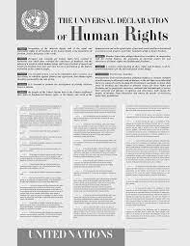
1. Why was the Universal Declaration of Human Rights written?
Because the League of Nations failed
As a result of the Civil War
As a result of the Holocaust and WWII
Because Eleanor Roosevelt was a powerful leader

Slide 3

2. What is the historical significance of the UDHR?
It started a new country
It established new laws
It abolished slavery around the world
It attempted to get all countries to acknowledge that freedom and equality (among other rights) should be universal

Slide 4
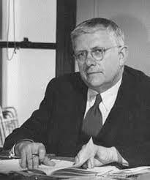
3. What is name of the Australian who played a significant role in the formation of the United Nations?
Robert Menzies.
Franklin D. Roosevelt.
Paul Keating.
Herbert V. Evatt

Slide 5
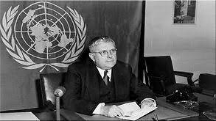
4. What role did Doc Evatt play in the creation of the Universal Declaration of Human Rights??
He was elected the third President of the General Assembly of the UN.
oversaw the vote by the UN countries to accept the UDHR.
persuaded the then sceptical Australian Government to vote in favour of the Universal Declaration.
All of the above.

Slide 6
5. How many articles are written in the Universal Declaration of Human Rights??
20
35
30
12

Slide 7

6. What is the name of the organisation which formed in 1945 and developed the UNDHR?
League of Nations
Circle of Nations
Unified Nations
United Nations

Slide 8
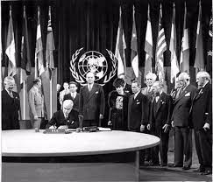
7. In which year was the United Nations formed?
1940, during WWII
1945, after WWII
1918, after WWI
2020, during the COVID outbreak

Slide 9
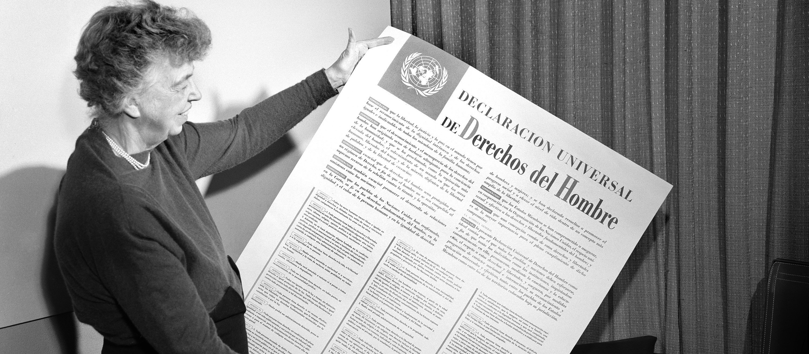
8. Who is this woman?
Eleanor Roosevelt
Queen Mary II
Hansa Mehta
Angela Merkel

Slide 10
9. Which country did Eleanor Roosevelt represent when writing the UNDHR?
England
The USA
Australia
Germany

Slide 11
Answers

Slide 12
1. Why was the Universal Declaration of Human Rights written?
Because the League of Nations failed
As a result of the Civil War
As a result of the Holocaust and WWII
Because Eleanor Roosevelt was a powerful leader

Slide 13
2. What is the historical significance of the UDHR?
It started a new country
It established new laws
It abolished slavery around the world
It attempted to get all countries to acknowledge that freedom and equality (among other rights) should be universal

Slide 14
3. What is name of the Australian who played a significant role in the formation of the United Nations?
Robert Menzies.
Franklin D. Roosevelt.
Paul Keating.
Herbert V. Evatt

Slide 15
4. What role did Doc Evatt play in the creation of the Universal Declaration of Human Rights??
He was elected the third President of the General Assembly of the UN.
oversaw the vote by the UN countries to accept the UDHR.
persuaded the then sceptical Australian Government to vote in favour of the Universal Declaration.
All of the above.

Slide 16
5. How many articles are written in the Universal Declaration of Human Rights??
20
35
30
12

Slide 17
6. What is the name of the organisation which formed in 1945 and developed the UNDHR?
League of Nations
Circle of Nations
Unified Nations
United Nations

Slide 18
7. In which year was the United Nations formed?
1940, during WWII
1945, after WWII
1918, after WWI
2020, during the COVID outbreak

Slide 19
8. Who is this woman?
Eleanor Roosevelt
Queen Mary II
Hansa Mehta
Angela Merkel

Slide 20
9. Which country did Eleanor Roosevelt represent when writing the UNDHR?
England
The USA
Australia
Germany

